Slide 1


Patterns, Language, and Documents (Part 1)
John Beverley
Assistant Professor, University at Buffalo
Co-Director, National Center for Ontological Research
Affiliate Faculty, Institute of Artificial Intelligence and Data Science

Slide 2
Outline
Real Patterns
From Language to Speech Acts
From Speech Acts to Document Acts

Slide 3
Outline
Real Patterns
From Language to Speech Acts
From Speech Acts to Document Acts

Slide 4

Pattern Recognition
We’re disposed to recognize patterns with our perceptual faculties…

Slide 5


Pattern Recognition
We’re disposed to recognize patterns with our perceptual faculties…
…and with our cognitive faculties…
Photo 51 crystallography image by Rosalind
Double-helix hypothesized by Watson and Crick

Slide 6
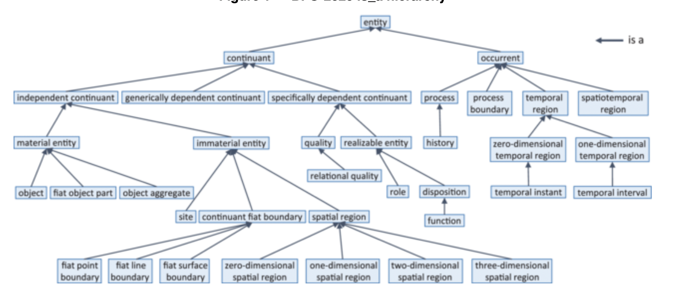
Patterns in Basic Formal Ontology?

Slide 7
BFO 1.0
Earlier versions of BFO did not permit dependent entities to migrate from bearer to bearer
This is true in current versions of BFO for many cases, e.g. your smile is dependent on your face
Dependent entities that cannot migrate fall under the class Specifically Dependent Continuant

Slide 8
Patterns
A need arose to represent dependent entities that could migrate across bearers
This need led to generically dependent continuants, continuants that are in some sense copyable, i.e. patterns
For example, “Snow is white” and “Schnee ist weiß” may be used to express numerically identical content, i.e. the same pattern

Slide 9
Patterns in Basic Formal Ontology

Slide 10
Real Patterns*
X is a real pattern just in case:
X is projectible under at least one physically possible perspective and
X encodes information about at least one structure of events or entities S where that encoding is more efficient, in information-theoretic terms, than the bitmap encoding of S, and where for at least one of the physically possible perspectives under which the pattern is projectible, there exists an aspect of S which cannot be tracked unless the encoding is recovered from the perspective in question.
*Dennett and Ross

Slide 11
Real Patterns*
X is a real pattern just in case:
X is projectible under at least one physically possible perspective and
X encodes information is about at least one entity structure of events or entities S where that encoding is more efficient, in information-theoretic terms, than the bitmap encoding of S, and where for at least one of the physically possible perspectives under which the pattern is projectible, there exists an aspect of S which cannot be tracked unless the encoding is recovered from the perspective in question.
*Loosely inspired by Dennett and Ross

Slide 12
Real Patterns
Some patterns are necessarily about something; some patterns are not
“Snow is white” expresses content that is about snow
“cm” is not necessarily about anything; it is nevertheless a pattern
Most generically dependent entities represented in BFO extensions are patterns that are about something

Slide 13
Aboutness
Information is a pattern that is about something
In BFO extensions - such as the Information Artifact Ontology and the Information Entity Ontology - information is represented by the class Information Content Entity
Where the “is about” relation is understood to be primitive:

Slide 14
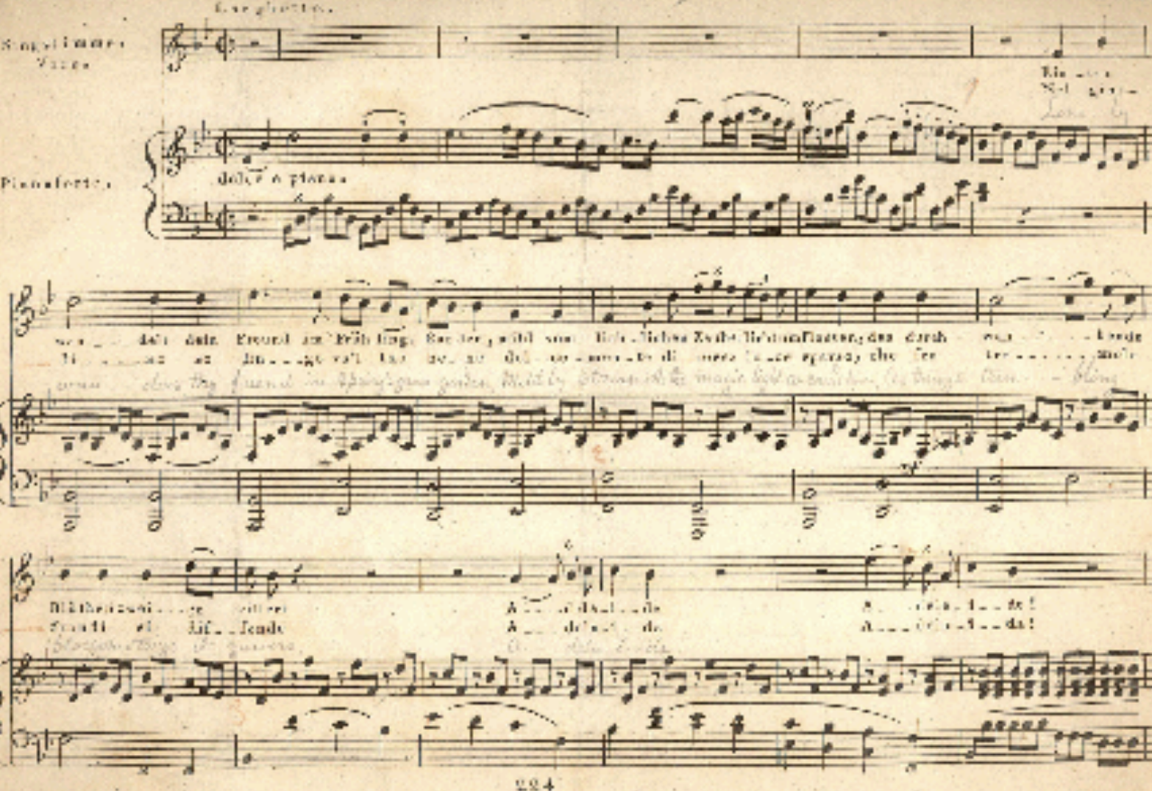
#9 Concretized in Ink Inscription
Information Content
Entity
Specifically Dependent
Continuant
CLASSES
Musical Work
Information
Quality Entity
Ink
Inscription
Symphony
INSTANCES
Beethoven’s #9

Slide 15
Ink Inscription inheres in Parchment
Specifically Dependent
Continuant
Material Entity
CLASSES
Information
Quality Entity
Information
Bearing Entity
Parchment
Ink
Inscription
INSTANCES

Slide 16
#9 Generically Dependent On Parchment
Information Content
Entity
Material Entity
CLASSES
Musical Work
Information
Bearing Entity
Parchment
Symphony
INSTANCES
Beethoven’s #9

Slide 17
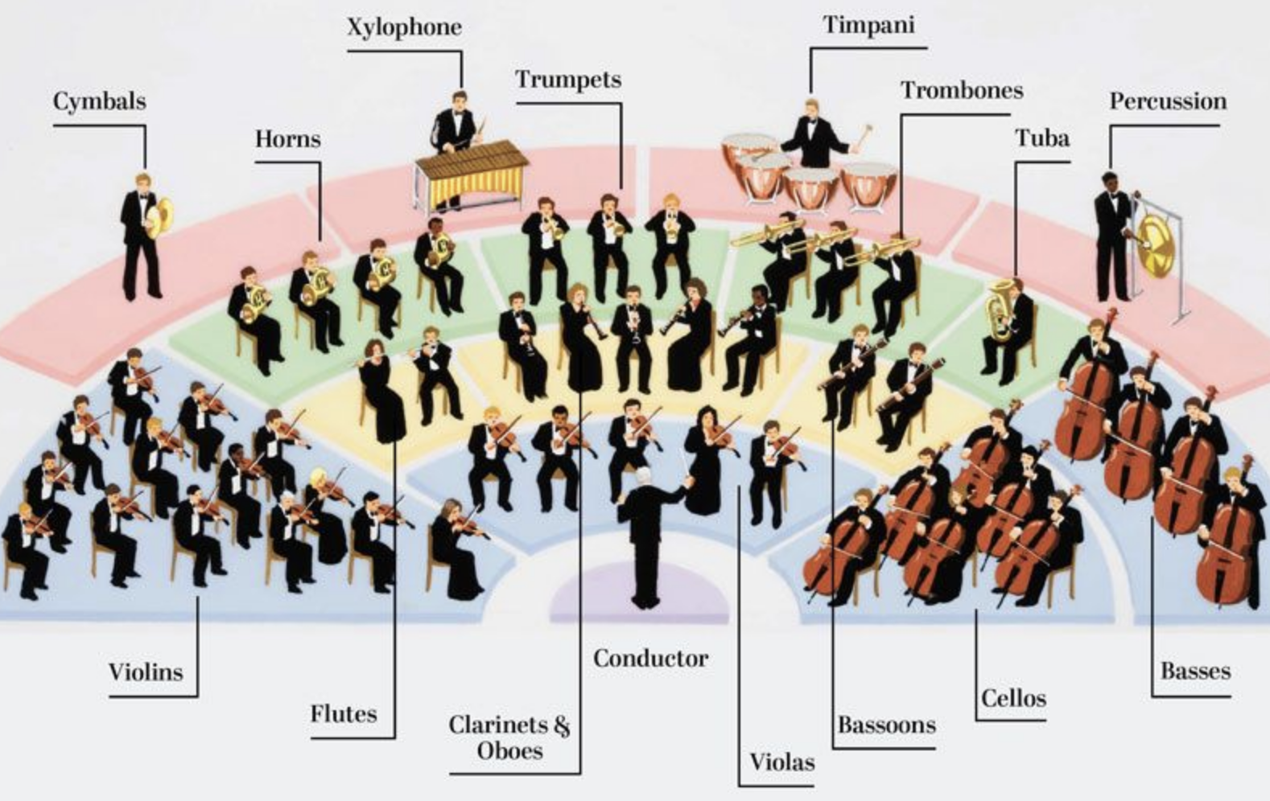
#9 is about Orchestra Plan
Information Content
Entity
Information Content
Entity
CLASSES
Musical Work
Plan Specification
Orchestra Plan
Symphony
INSTANCES
Beethoven’s #9

Slide 18
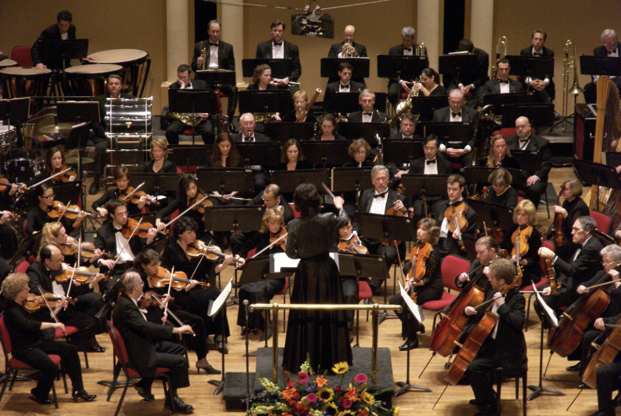
Musician Plan realized in #9 Performance
Disposition
Process
CLASSES
Plan
Planned Process
Musician Plan
#9 Performance
INSTANCES

Slide 19
Beethoven’s #9th Symphony
Beethoven’s #9
is about
generically depends on
concretized
in
concretized in
inheres in
has realization

Slide 20
Outline
Real Patterns
From Language to Speech Acts
From Speech Acts to Document Acts

Slide 21
Authority
Many intelligence activities involve government agents and agencies, which have degrees of authority to direct and leverage intelligence
Questions of authority emerge during mission failures and successes, checks and balances, rational historical reconstructions
It is incumbent on us that we explore relationships between intelligence analysis and relevant authority

Slide 22
BFO: Deontic Entities
An adequate account of such deontic entities will require at a minumum ontological characterizations of:
Social dispositions, e.g. customs, languages, rituals, institutions, etc.
Speech acts, e.g. imperatives, interrogatives, etc.
Mental functioning, e.g. beliefs, knowledge, hopes, etc.
Social acts, e.g. promising, praising, blaiming, etc.
Documents, e.g. credentials, authorized reports, etc.
Authorities, e.g. governments, institutions, etc.

Slide 23
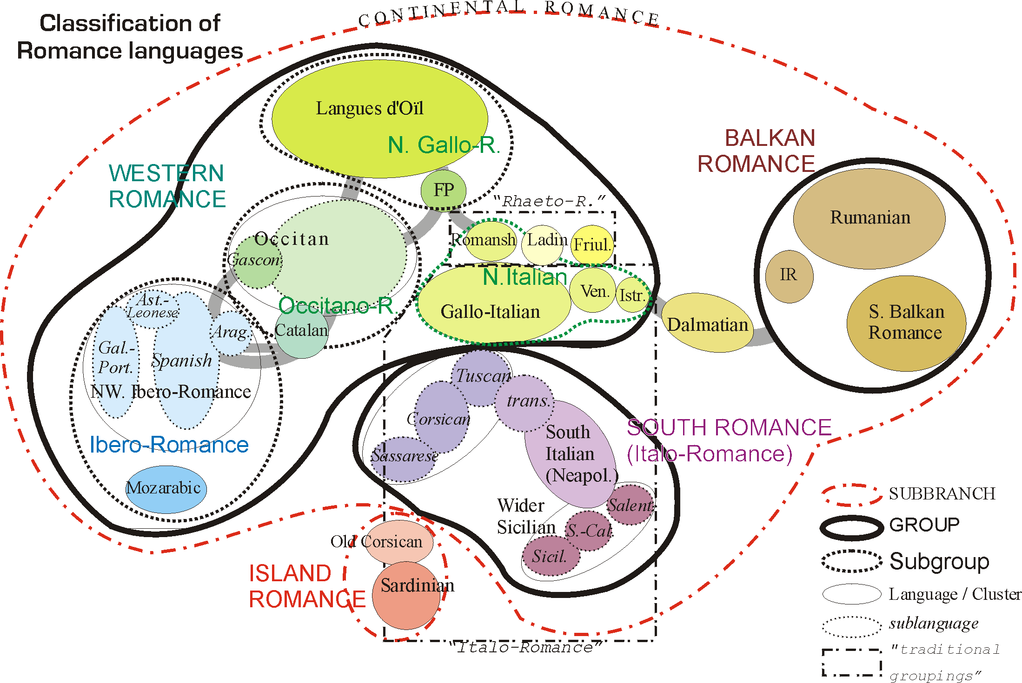
Chomsky on E-Language
"Language" may mean the sociopolitical vernacular that we learn in our communities, i.e. E-language.
E-Language is external, communal, changeable, and may be corrected. For example, the term "livid" means "cold, blue with anger" and yet most people seem to think it means "hot, red with anger."

Slide 24
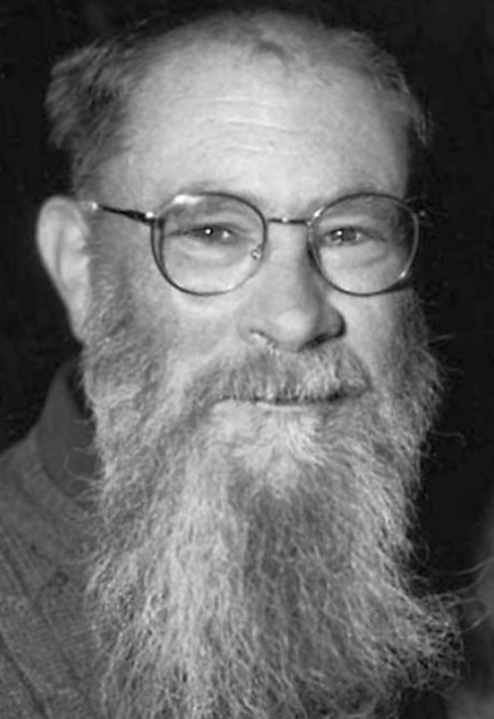
Lewis on Convention
A regularity R is a convention just in case:
Everyone conforms to R
Everyone believes others conform to R
This belief gives everyone a good reason to conform to R himself
Everyone believes others are doing the best they can to conform to R
R is not the only possible regularity meeting (3) and (4)
Each of the preceding factors are in principle common knowledge

Slide 25
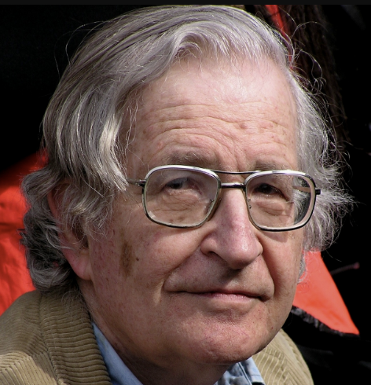
Chomsky on I-Language
"Language" may also mean the internal, innate, unchanging foundation for linguistic competence, e.g. I-Language
Chomsky claimed I-Language was the proper target of linguistics, as it reveals the computational system of the brain

Slide 26
Beverley on I-Logic
Linguistics competence consists of dispositions borne by an agent
There must be an innate competence for logical reasoning since language depends on drawing distinctions
The picture:*
Foundational logic competence (I-Logic) grounds for
Foundational linguistic competence (I-Language) grounds for
Derivative linguistic competence (E-language) grounds for
Derivative logic competence (E-Logic)
* Beverley, Trust Logic, Not Tortoises

Slide 27

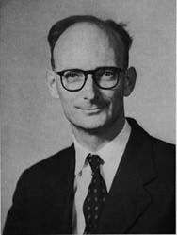
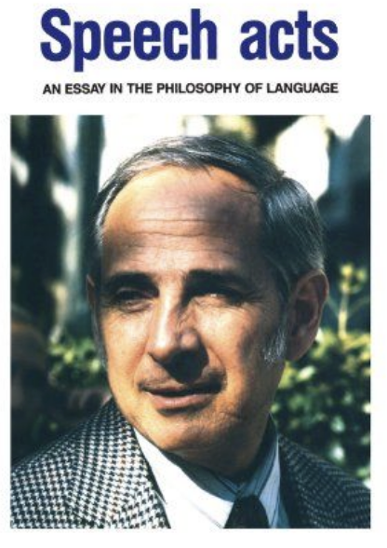
Speech Acts
While speech is any act of uttering, a speech act is an act in which an agent intends to convey meaning that is performed by the act
Example categories of speech act include:
Assertion
Directive
Commissive
Expressive
Declaration

Slide 28
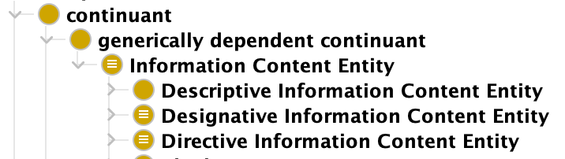
Speech Acts
While speech is any act of uttering, a speech act is an act in which an agent intends to convey meaning that is performed by the act
Example categories of speech act include:
Assertion
Directive
Commissive
Expressive
Declaration
Information Entity Ontology – Common Core Ontologies

Slide 29
Directions of Fit for Speech Acts
Speech act types can be distinguished in terms of their direction of fit
World-to-Word: Make world fit the words, e.g. directive
Word-to-World: Make words fit the world, e.g. descriptive
Creation-of-Fit: Words change the world, e.g. declarative

Slide 30

Social World Ingredients
Performance of speech acts such as promising, asserting, excusing, etc. agents create:
Claims and Obligations
Authorities and Responsibilities
Memberships and Exclusions
Which are ingredients in the ontology of the social world

Slide 31
Claims and Obligations
If Sam promises Sally to perform X, then Sam acquires an obligation to perform X
Similarly, Sally acquires a claim on Sam that he perform X
The claim and obligation are mutually dependent, i.e. mutually specifically dependent roles

Slide 32
Claims and Obligations in BFO
As with other roles in BFO, claims and obligations are underwritten by the dispositions of the parties involved
Sam’s obligation is grounded in:
dispositions inhering in Sally
Or dispositions inhering in the wider society
To hold Sam accountable (e.g. punish, shame, shun, scold, etc.) if he fails to perform X as promised

